Slide 1
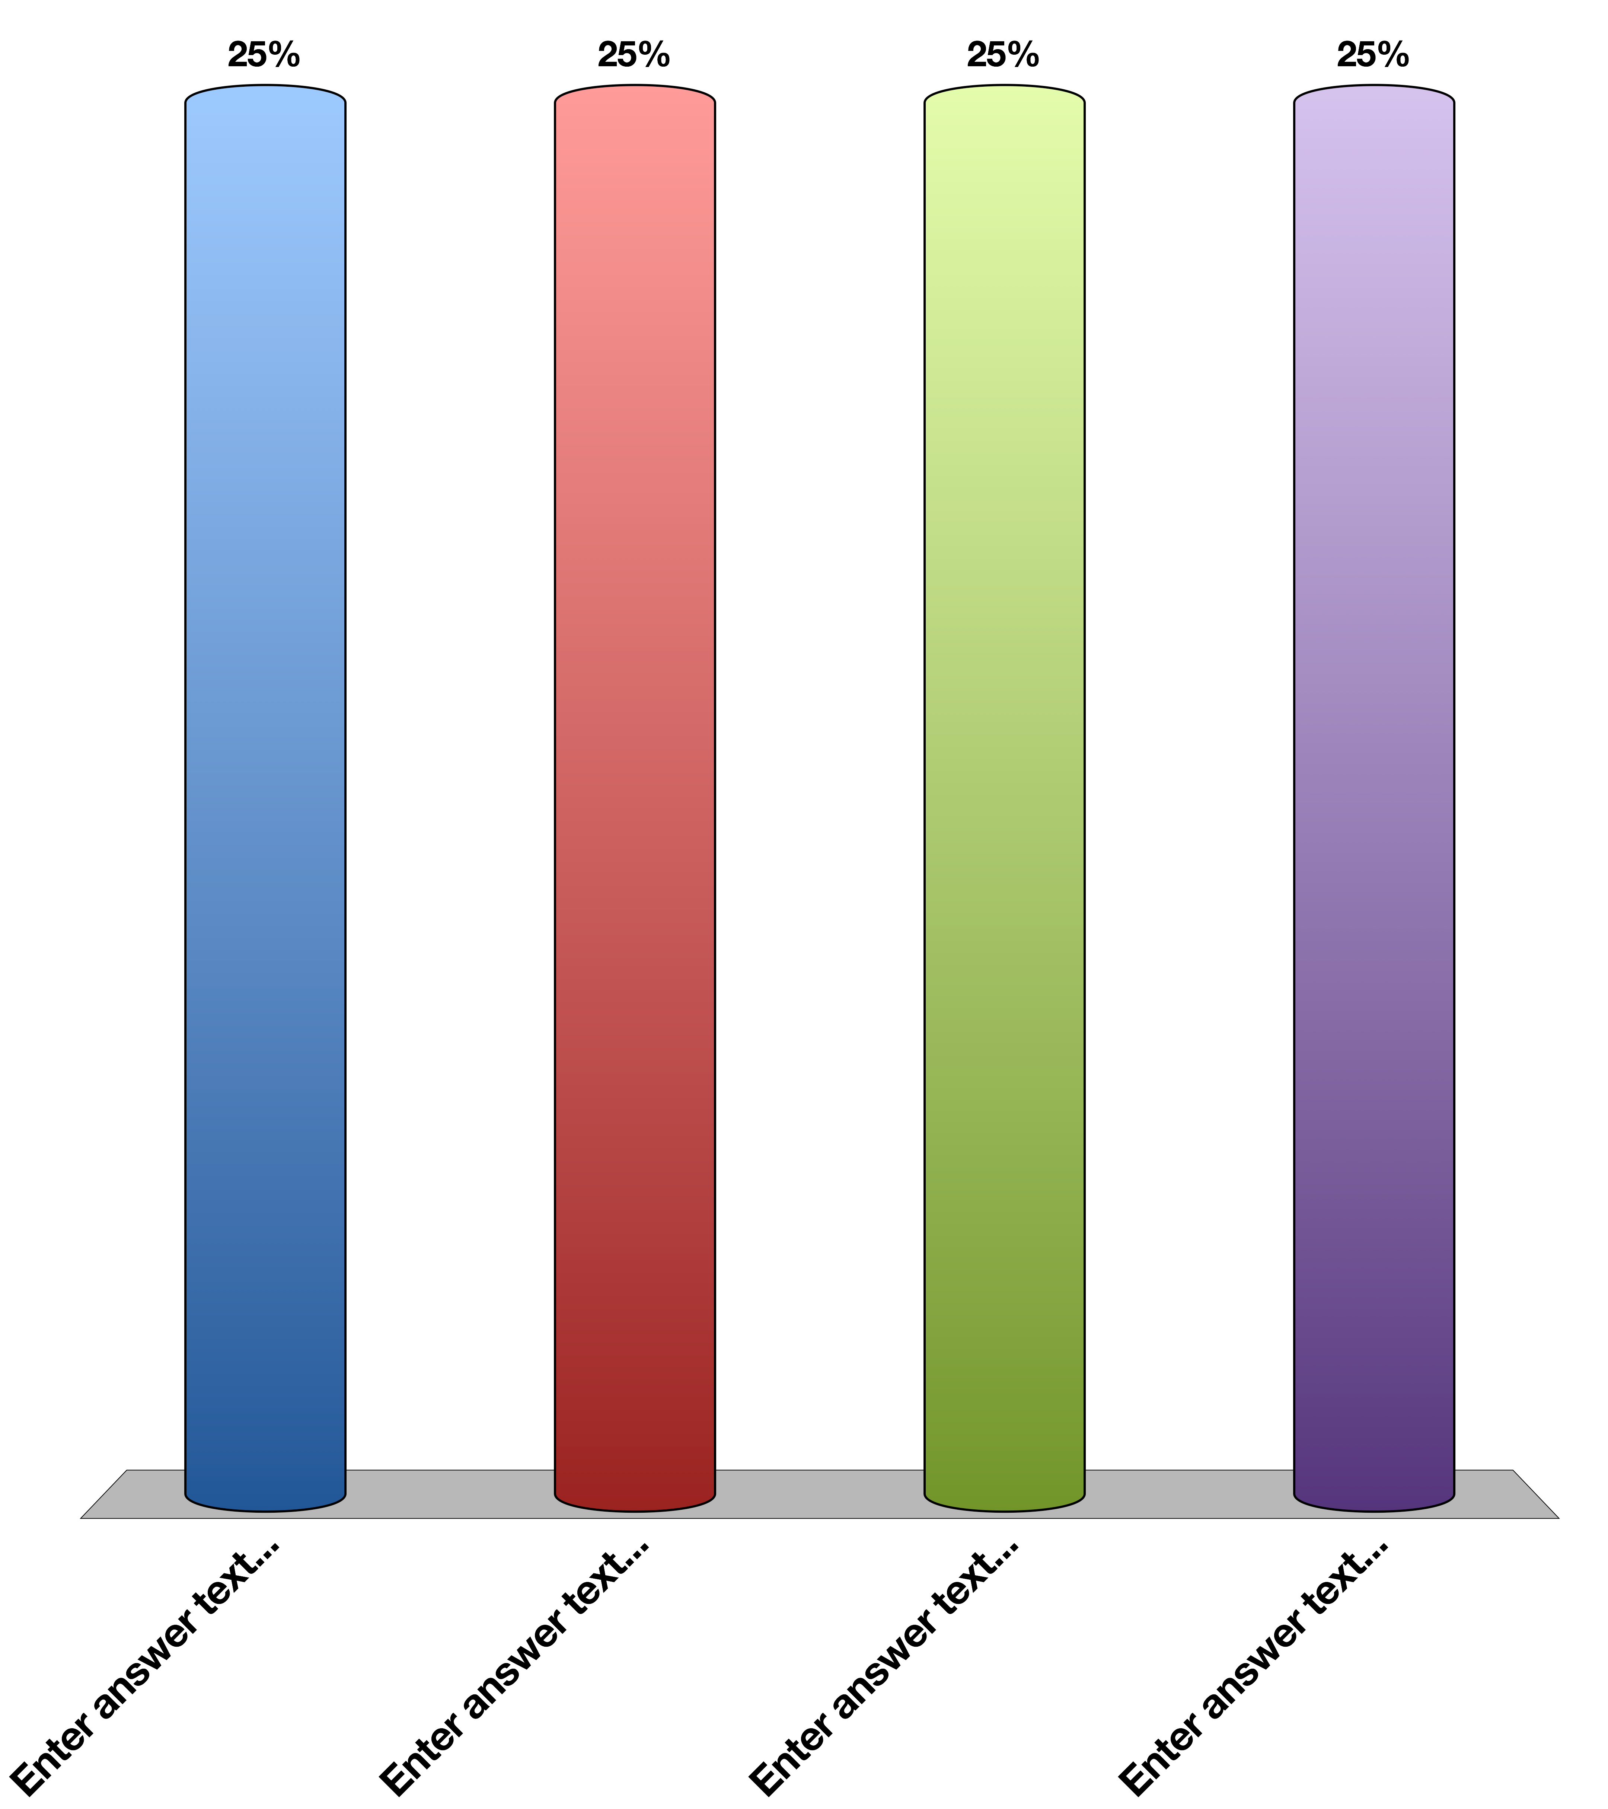
Which of the following hormones suppresses gluconeogenesis
Adrenaline
Cortisol
Glucagon
Insulin
Response Counter
60

